Slide 1
1

Slide 2

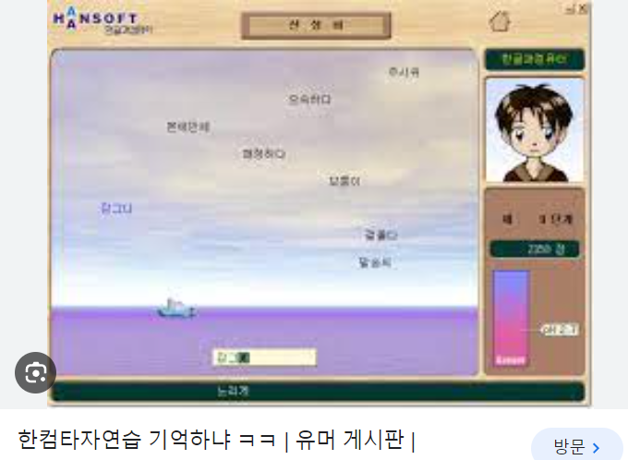

Slide 3





https://ko.ac-illust.com/search-result/similar/568710?same_creator=1&data_id=568710

Slide 4






Slide 5











Slide 6
















Slide 7
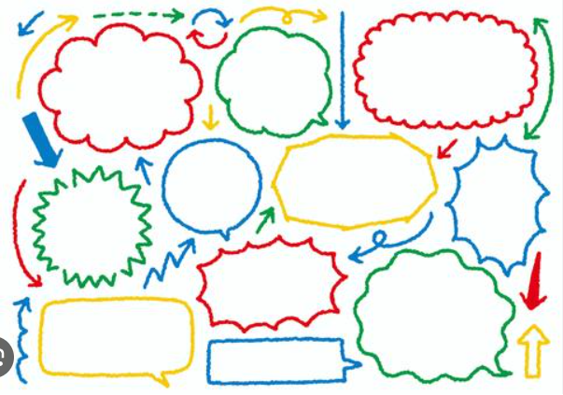


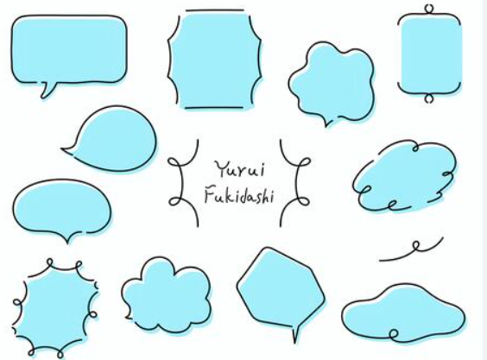


Slide 9


Slide 10
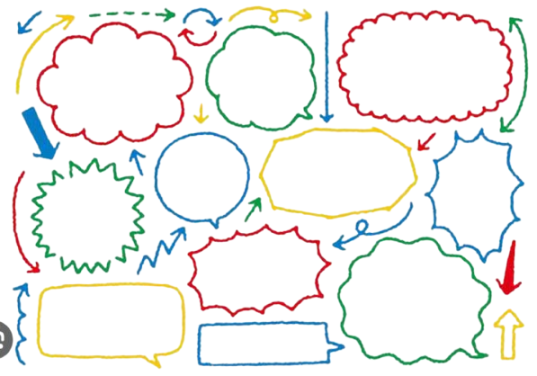


Slide 12
2

